Slide 1




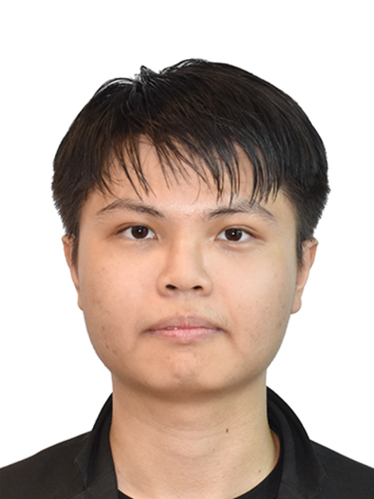

collaborated with EY
HPO Experiment
Hyperparameter Optimization using Half Grid Search, Genetic Algorithm, Simulated Annealing and Comparison with Grid Search
Presenter
Supervisor
Wong Yan Jian (U2102753/1)
Associate Prof. TS. Dr. Sri Devi A/P Ravana
Notes:
Good morning to panels, I am Wong Yan Jian and my data science project is focused on HPO Experiment, or its full name – Hyperparameter Optimization using Half Grid Search, Genetic Algorithm, Simulated Annealing and Comparison with Grid Search. This project was conducted under the guidance from supervisor Associate Prof. Dr. Sri Devi and collaborated with EY.

Slide 2



HPO Experiment
Table of Contents
Experiment
Introduction
3
1
Experiment Design
Problem Statements
Results and Findings
Objectives
Demonstration
4
Methodology
Streamlit Demonstration
2
Tools
Conclusion
Project Flow
5
Hyperparameter Tuning Methods
Conclusion & Future Works
Notes:
Here are the agenda.

Slide 3
HPO Experiment
INTRODUCTION
Notes:
Introduction

Slide 4
HPO Experiment
Introduction
Introduction
Machine Learning -> ML
Hyperparameter Optimization -> HPO
Hyperparameters are a set of settings that are used for configuring ML model and minimizing loss function. (Yang and Shami, 2020)
Modern ML models like tree-based and deep neural networks have many hyperparameters to tune. (Hutter el al, 2019)
Vast HPO search spaces and curse of dimensionality challenge traditional Grid Search approaches as such method is exhaustive and inefficient. (Cooper el al., 2021)
Advanced algorithmic strategies like Half Grid Search, Genetic Algorithm, and Simulated Annealing offer sophisticated solutions to HPO complexities. (Bischl et al., 2023)
Notes:
So, what Is hyperparameter? Based on Yang and Shami’s paper, hyperparameters are basically a set of settings that are used for configuring ML model and minimizing loss function || (like reducing MSE score in linear regression.) ||
In the current era, modern ML models like tree-based and deep neural networks have many hyperparameters to tune || ((and each of the hyperparameters itself has even more range of values to tune with)).
Because of this, the vast HPO search spaces and curse of dimensionality challenge traditional Grid Search approach, as it is exhaustive and inefficient. Hence, to tackle this issue, advanced algorithmic strategies can use as an alternative to Grid Search. ((like Half Grid Search, Genetic Algorithm and Simulated Annealing))

Slide 5
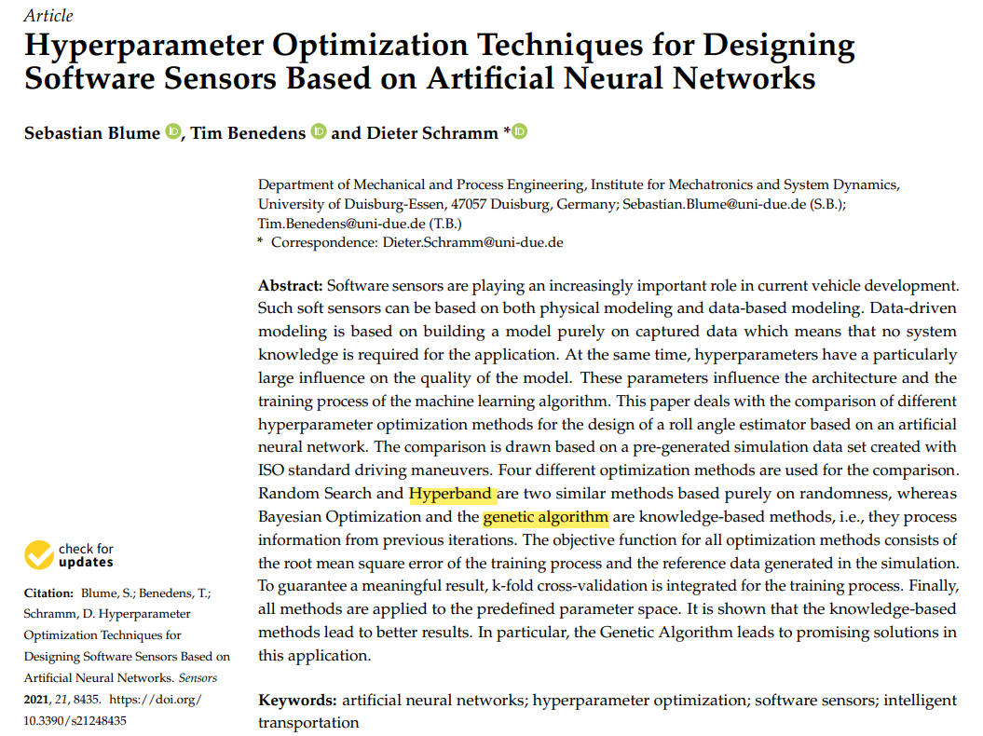
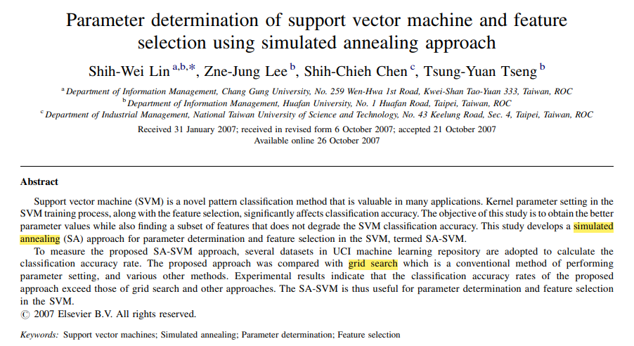
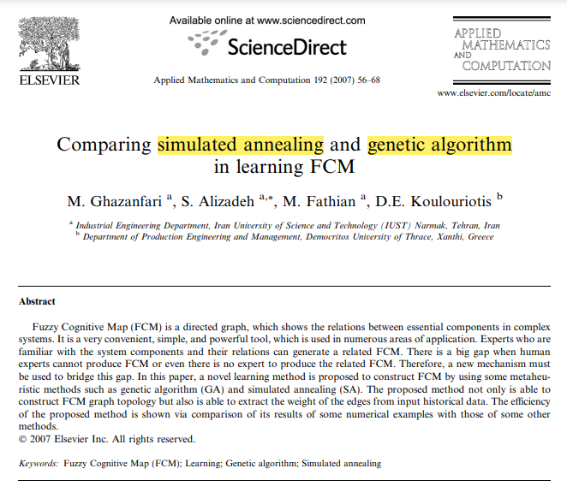
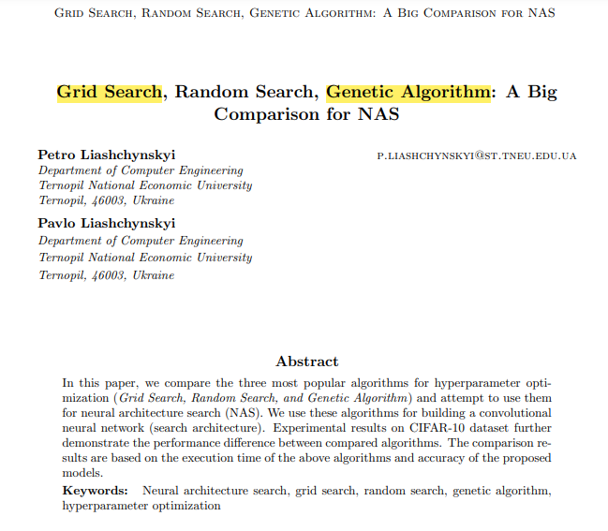
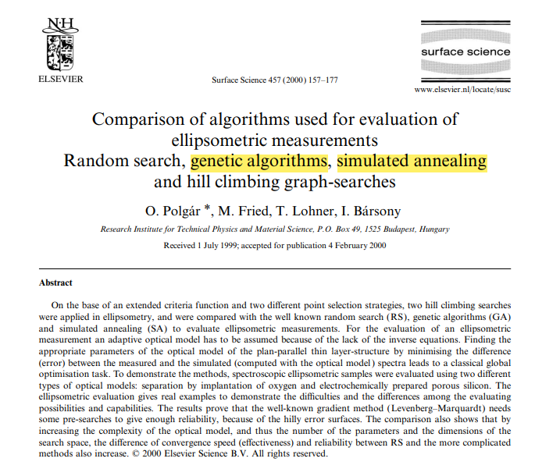
HPO Experiment
Introduction
Problem Statement
Most researches focused on comparison between Grid Search, Genetic Algorithms and Simulated Annealing.
Notes:
And You might be wondering: which of these methods is most suitable? How much better are the hyperparameters found using these techniques? Unfortunately, there is currently no study that directly compares all four methods.

Slide 6
HPO Experiment
Introduction
Problem Statement
Identified research gaps in comparative analysis between Half Grid Search, Grid Search, Genetic Algorithm and Simulated Annealing:
1
Lack of assessment into computation efficiency required by each optimization method
2
Limited evaluation of hyperparameter solution found by each optimization method
Lack of quantification of the diversity in hyperparameter solutions by each optimization method
3
(Polgár, 2000) | (Ghazanfari, 2007) | (Lin et al., 2007) | (Petro and Pavio, 2019) | (Sebastian et al., 2021)
Notes:
Unfortunately, there is currently no study that directly compares all four methods. And this introduce the research gaps, including lack of assessment into computation efficiency, limited evaluation of hyperparameter solution, and lack of quantification of the diversity in hyperparameter solutions found by each optimization method

Slide 7
HPO Experiment
Introduction
Objectives
To explore and compare different optimization methods, following objectives need to be achieved:
To measure and compare average computation time for finding optimal set of hyperparameters
1
To assess quality of hyperparameters found by each method with suitable performance metric
2
To quantify diversity of hyperparameters evaluated by each method to assess their exploratory capabilities
3
Notes:
Therefore, the objective of this research is to explore and compare these 4 methods, by comparing average computation time, assessing quality of hyperparameter, and quantifying the diversity of hyperparameters found by each method

Slide 8
HPO Experiment
METHODOLOGY
Notes:
Next, we proceed to Methodology.

Slide 9
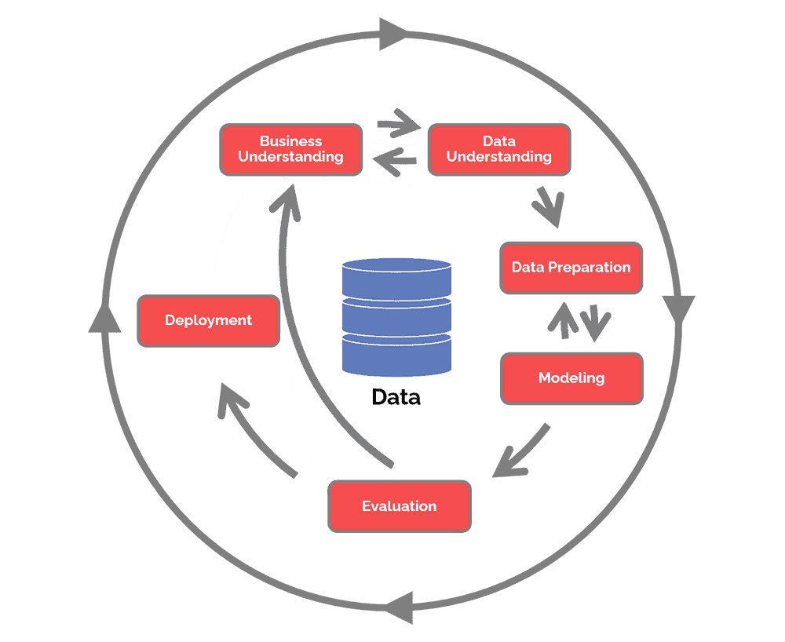
HPO Experiment
Methodology
Methodology
CRISP-DM
Business Understanding
Conduct comparative analysis of Half Grid Search, Simulated Annealing and Genetic Algorithm with Grid Search
Data Understanding
Explore dataset to understand dataset
Data Preparation
Preprocess data for experiment
(Wirth and Hipp, 2000) | (Bandgar, 2021) | (Schroer et al., 2021)
Modelling
Build Logistic Regression, Support Vector Classifier, Random Forest Classifier and Gradient Boosting Classifier with different hyperparameters
Evaluation
Utilize different evaluation metrics to achieve objectives
Deployment
Deploy models, codes and findings in Streamlit
Notes:
In this project, I have implemented CRISP-DM to conduct HPO experiment. It starts with business understanding, followed by data understanding, data preparation

Slide 10
HPO Experiment
Methodology
Methodology
CRISP-DM
Modelling
Build Logistic Regression, Support Vector Classifier, Random Forest Classifier and Gradient Boosting Classifier with different hyperparameters
Business Understanding
Conduct comparative analysis of Half Grid Search, Simulated Annealing and Genetic Algorithm with Grid Search
Evaluation
Data Understanding
Utilize different evaluation metrics to achieve objectives
Explore dataset to understand dataset
Deployment
Data Preparation
Deploy models, codes and findings in Streamlit
Preprocess data for experiment
(Guo et al., 2019)
Notes:
Modelling, evaluation and lastly deployment.

Slide 11















HPO Experiment
Methodology
Tools
Software & Platform
Python Libraries
Notes:
Here are the tools that I have used in my project

Slide 12

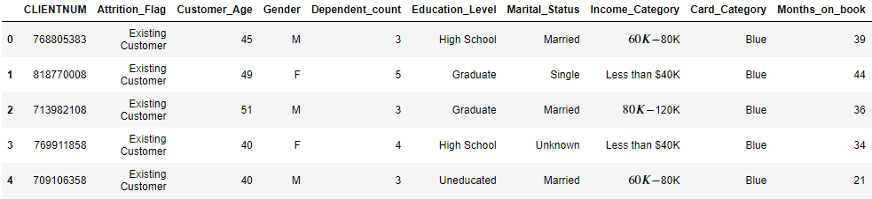
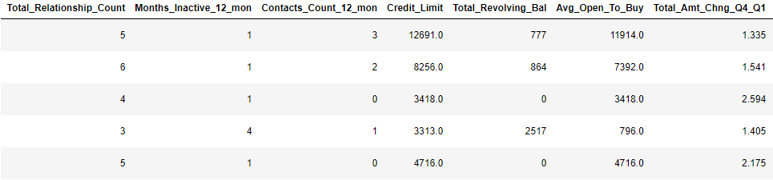
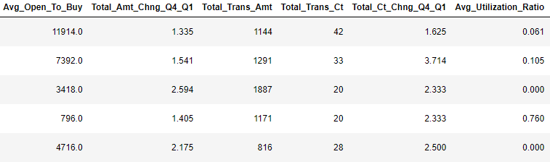
HPO Experiment
Methodology
Project Flow
Data Understanding
(Goyal, 2020)
Notes:
And now let’s get some understanding on the dataset. I used Credit Card customer dataset from Kaggle.

Slide 13
HPO Experiment
Methodology
Project Flow
Data Understanding
Number of Records
Number of Features
Binary Classification
10,127
21
Attrition_Flag
Existing / Attrited
14 numerical features
4 ordinal features
3 nominal features
(Goyal, 2020)
Notes:
It has around 10k of records, with 20 features and mainly used for binary classification.

Slide 14
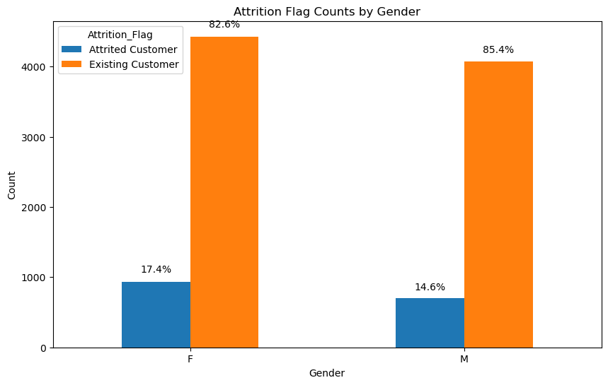


HPO Experiment
Methodology
Project Flow
Data Understanding
Imbalanced classes for attrition flag
Can tackle with SMOTE
Notes:
Now let’s head to EDA. First from this bar chart, we see there are imbalanced classes for attrition flag, which require action like SMOTE to tackle it

Slide 15
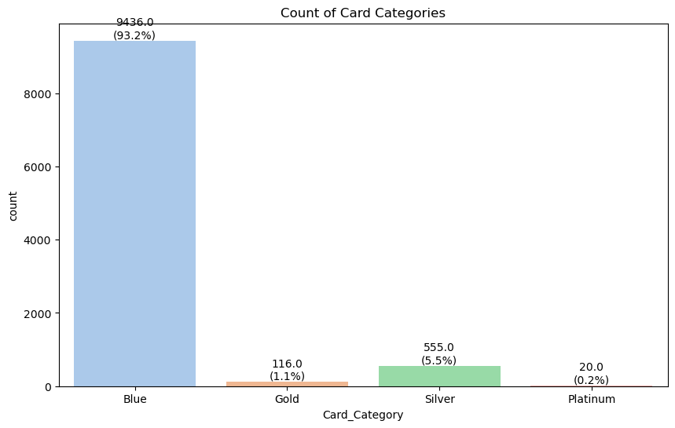
HPO Experiment
Methodology
Project Flow
Data Understanding
Number for gold and platinum card categories are small
Can combine together during mapping
Notes:
Next, this bar chart shows that there are less number for gold and platinum card categories. These can be combined in mapping.

Slide 16
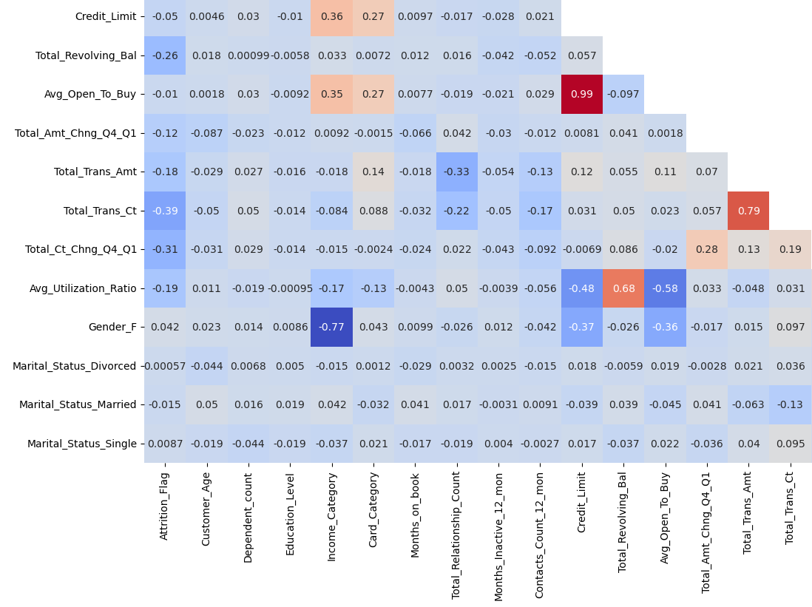
HPO Experiment
Methodology
Project Flow
Data Understanding
Avg_Open_To_Buy is highly correlated with Credit_Limit
Can remove it
Notes:
For this correlation graph, we can see feature like Avg_Open_To_Buy is highly correlated with Credit Limit at 0.99, which we can remove it to reduce number of features used in prediction later.
Average Open to Buy = Credit Limit * (1 – Credit Utilization Ratio)
Credit Utilization Ratio = Total Balance / Total Credit Limit * 100

Slide 17
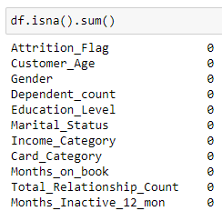
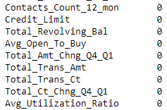
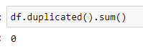
HPO Experiment
Methodology
Project Flow
Data Preparation
1
2
3
4
5
6
7
8
Check for missing and duplicated values
Mapping for ordinal columns
One-hot encoding for nominal columns
Remove one column from one-hot encoded feature
Drop highly correlated feature
Prepare training and testing set
Remove outliers
Normalize data
No duplicated or missing values
Notes:
Next, for data preparation stage, it starts with checking for missing and duplicated values. Fortunately, there are no duplicated or missing values.

Slide 18
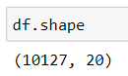
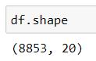
HPO Experiment
Methodology
Project Flow
Data Preparation
1
2
3
4
5
6
7
8
Check for missing and duplicated values
Mapping for ordinal columns
One-hot encoding for nominal columns
Remove one column from one-hot encoded feature
Drop highly correlated feature
Prepare training and testing set
Remove outliers
Normalize data
remove 1274 records
Records that have more than one column with outliers are removed
Notes:
Outliers then are removed based on the records that have more than one column with outliers.

Slide 19
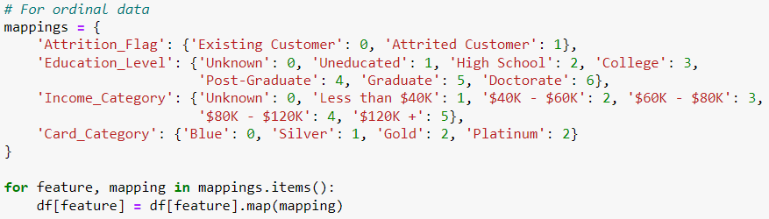
HPO Experiment
Methodology
Project Flow
Data Preparation
1
2
3
4
5
6
7
8
Check for missing and duplicated values
Mapping for ordinal columns
One-hot encoding for nominal columns
Remove one column from one-hot encoded feature
Drop highly correlated feature
Prepare training and testing set
Remove outliers
Normalize data
4 ordinal columns are mapped
Notes:
After that, ordinal data are mapped.

Slide 20
HPO Experiment
Methodology
Project Flow
Data Preparation
1
2
3
4
5
6
7
8
Check for missing and duplicated values
Mapping for ordinal columns
One-hot encoding for nominal columns
Remove one column from one-hot encoded feature
Drop highly correlated feature
Prepare training and testing set
Remove outliers
Normalize data
2 nominal columns are one-hot encoded
Notes:
Followed by one-hot encoding for nominal columns.

Slide 21
HPO Experiment
Methodology
Project Flow
Data Preparation
1
2
3
4
5
6
7
8
Check for missing and duplicated values
Mapping for ordinal columns
One-hot encoding for nominal columns
Remove one column from one-hot encoded feature
Drop highly correlated feature
Prepare training and testing set
Remove outliers
Normalize data
2 columns are removed to reduce Variance Inflation Factor (VIF) score
(Chongqi and Lan, 2022)
Notes:
The fifth stage is to remove one column from one-hot encoded features.
(Optional)
This is done to reduce high VIF score (avoid issue of multicollinearity) for these features as the last value column can be predicted based on other columns.
(Optional)
By doing so, it can remove number of features used for simplifying the model while addressing multicollinearity issue in logistic regression. The effect of dropping these columns have minimal impact on model performance and at the same time improving model interpretability.

Slide 22
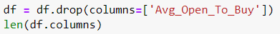
HPO Experiment
Methodology
Project Flow
Data Preparation
1
2
3
4
5
6
7
8
Check for missing and duplicated values
Mappings for ordinal columns
One-hot encoding for nominal columns
Remove one column from one-hot encoded feature
Drop highly correlated feature
Prepare training and testing set
Remove outliers
Normalize data
Avg_Open_To_Buy feature is removed, resulting in 21 columns
Notes:
Next highly correlated features like Avg Open To Buy is removed.

Slide 23
HPO Experiment
Methodology
Project Flow
Data Preparation
1
2
3
4
5
6
7
8
Check for missing and duplicated values
Mappings for ordinal columns
One-hot encoding for nominal columns
Remove one column from one-hot encoded feature
Drop highly correlated feature
Prepare training and testing set
Remove outliers
Normalize data
Training set: 7082
Testing set: 1771
Notes:
And then the dataset is splitted into training and testing set with 8 to 2 ratio

Slide 24
HPO Experiment
Methodology
Project Flow
Data Preparation
1
2
3
4
5
6
7
8
Check for missing and duplicated values
Mappings for ordinal columns
One-hot encoding for nominal columns
Remove one column from one-hot encoded feature
Drop highly correlated feature
Prepare training and testing set
Remove outliers
Normalize data
Perform Z-score normalization with StandardScaler
Notes:
After that, Z-score normalization is applied

Slide 25
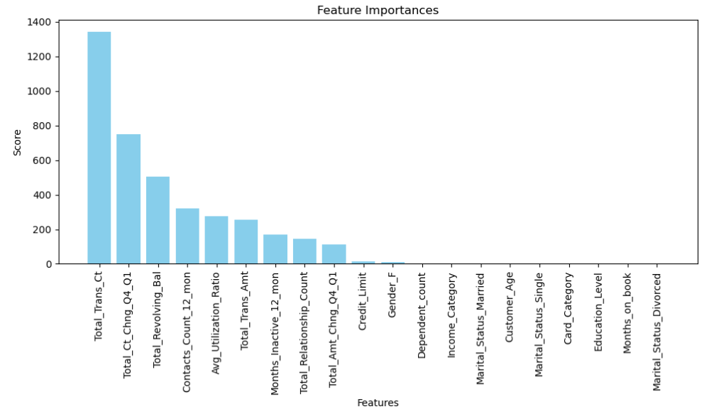
HPO Experiment
Methodology
Project Flow
Data Preparation
9
Permutation Importance with
Extra Tree Classifier
SelectKBest with f_classif
Data Understanding
Feature Selection
Select top 15 features
Fit to simple logistic regression
Result: 0.8938
Result: 0.8961
Top 15 features from SelectKBest
(Wu and Wang, 2022)
Notes:
And now for feature selection part, I employ two methods in evaluating suitable features for credit card churning. The first one is permutation importance with Extra Tree Classifier and second is SelectKBest to select top 15 features. These selected features are then fitted to a simple logistic regression and compute the prediction result. It shows that top 15 features from SelectKBest has a slightly higher accuracy score than Permutation Importance. So, these features will be used later.
(Optional)
Permutation Importance - shuffle the values in one feature at a time and measure the model’s performance, drop a lot -> feature is important
SelectKBest - use statistic – fclassif: compute ANOVA f-value

Slide 26
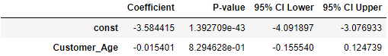
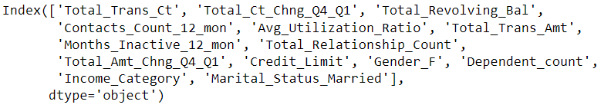
HPO Experiment
Methodology
Project Flow
Data Preparation
9
9
Data Understanding
Feature Selection
Conduct Wald Test to test the significance of selected variables
14 features left after removing Customer_Age
(Chongqi and Lan, 2022)
Notes:
Following that,Wald Test is used to evaluate the significance of selected variables. The result shows that Customer Age is not statistically significant at 5%. Therefore, this particular feature is removed, and 14 remaining features left

Slide 27

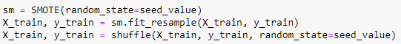
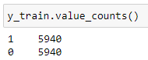

HPO Experiment
Methodology
Project Flow
Data Preparation
10
SMOTE & Shuffle
SMOTE is applied on training set to balance classes followed by shuffling
(Ismael el al., 2022)
Notes:
Lastly, SMOTE is applied at the end following Ismael’s approach.

Slide 28
HPO Experiment
Methodology
HYPERPARAMETER
TUNING METHODS
Notes:
Before we head into modelling part, let’s us have a basic understanding on each hyperparameter tuning method.

Slide 29
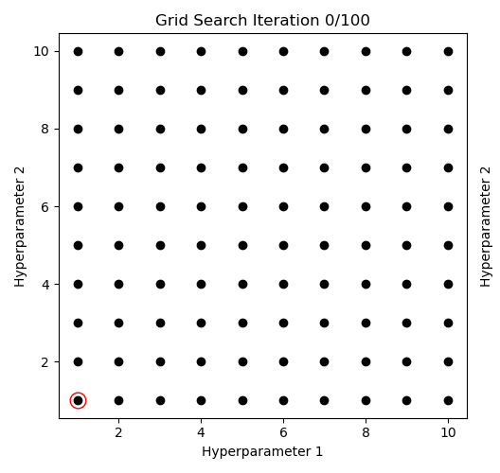
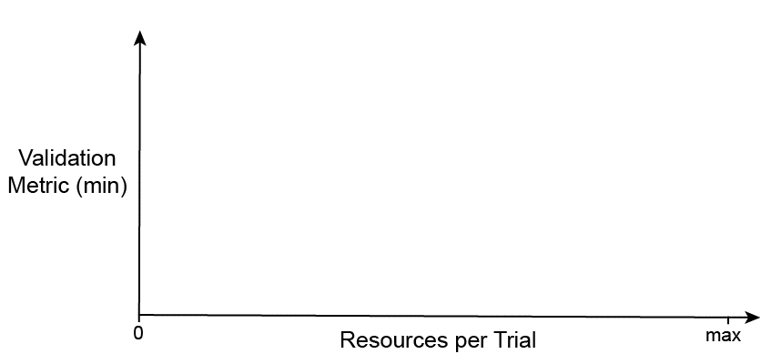
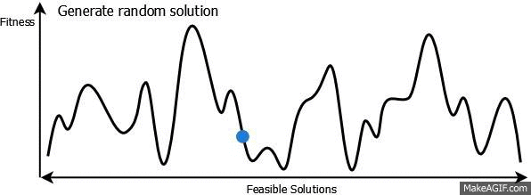
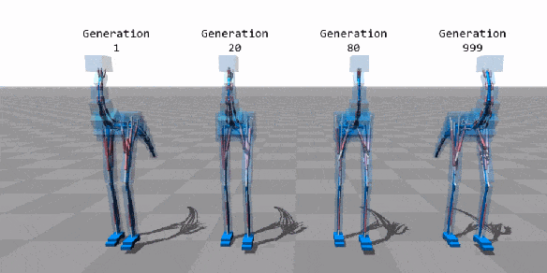
HPO Experiment
Methodology
Grid Search
Evaluate every possible combinations of given parameters and find the best one
(Farhad, 2020)
Notes:
The first one is grid search, which basically evaluate every possible combinations of given parameters and find the best one

Slide 30
HPO Experiment
Methodology
Half Grid Search
(successive halving)
Start by evaluating every possible combination with a small budget (a subset of data) for evaluation
Discard the half with low-performing combinations and double the budget for the remaining candidates
(Viresh, 2023)
Notes:
Next up is Half Grid Search. It starts by evaluating every possible combination with a small budget like a subset of data for evaluation, and then it will discard half with low-performing combinations and proceed to next iterations by doubling budget for remaining candidates

Slide 31
HPO Experiment
Methodology
Simulated Annealing
Start with a random solution, and then select a new configuration at each iteration
Calculate acceptance probability, allowing for acceptance of worst solutions at initial stage
Adjust temperature with cooling rate and continue until convergence
(Everton, 2023)
Notes:
Third one is simulated annealing. It starts with a random solution, and then select a new configuration at each iteration. It will accept the solution based on calculated acceptance probability. After that, temperature is adjusted and then cycle continues.

Slide 32
HPO Experiment
Methodology
Genetic Algorithm
Start with an initial population and evaluate them
Perform selection, crossover, mutation, and evaluation for new offspring, and replace discarded chromosome (a set of solution)
Continue until stopping criterion is met
(Annu el al., 2019)
Notes:
Last one is genetic algorithm. It starts with initial population and evaluate them with fitness function. Some best-performing parents are selected to perform crossover, mutation and evaluation to produce new offspring that can replace discarded one and this cycle stop when stopping criterion is met.

Slide 33
HPO Experiment
EXPERIMENT
Notes:
Next, let’s us move on to Experiment part.

Slide 34
HPO Experiment
Experiment
Experiment Design
Run on same Google Collaboratory environment
5 seeds are chosen to repeat the entire experiment, introduced at different phases
3-fold cross validation is used for evaluation
Focus on maximizing accuracy score during optimization
100 iterations for SA, 10 rounds for HGS, total 100 populations for GA
Introduce in Data Splitting
Introduce in Initializing Model
7
13
42
404
1001
Minimize effect of data splitting to assess exploratory capability
7 13 42 404 1001
To assess computation time and quality of hyperparameter found
Notes:
For this HPO experiment, it is run on the same Google Colab environment. 5 seeds have been chosen to repeat the entire experiment and each of them are introduced at different phases. As you can see on the diagram below, there are 5 experiments that involve introducing seed value during data splitting and another 5 during initializing model.
For evaluation, it will use 3-fold cross validation and specific conditions have been set to act as control.
(Optional)
3-fold cross validation - Split dataset into 3 parts, model train on two folds and test on last fold, evaluate performance and average the result.

Slide 35

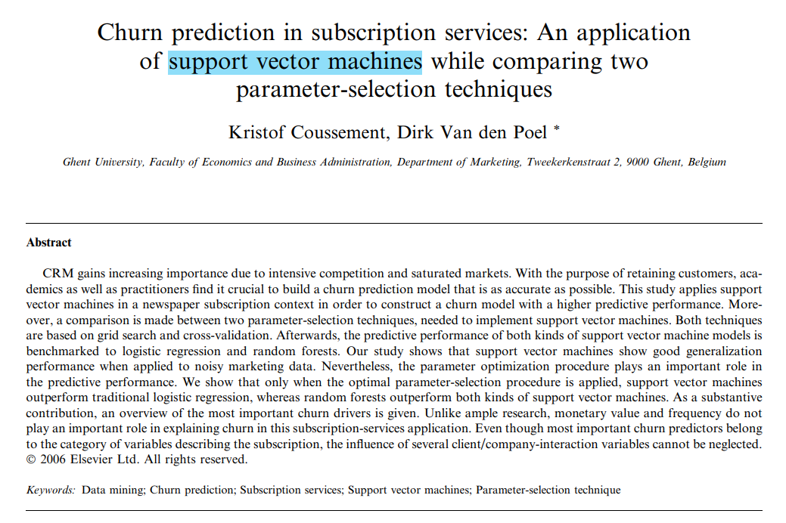
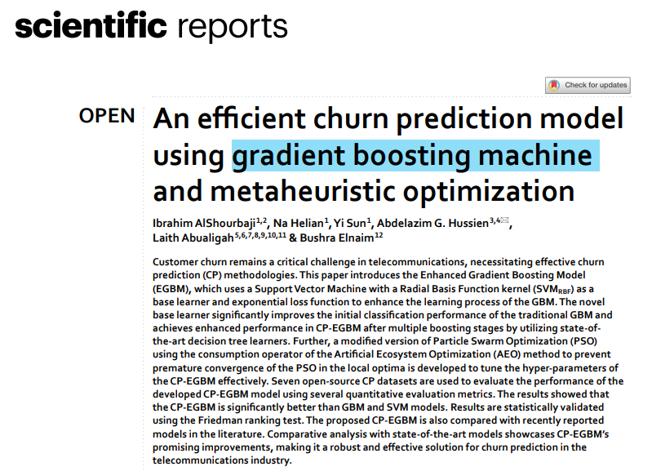
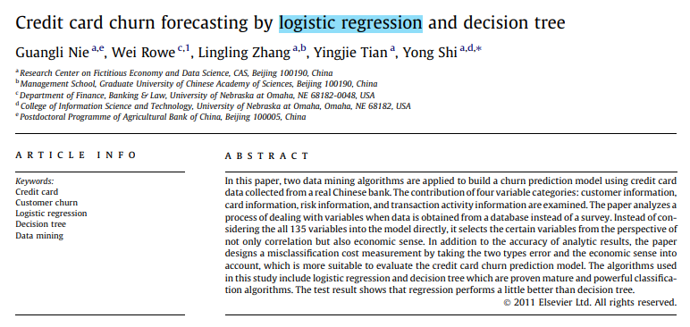
HPO Experiment
Experiment
Experiment Design
Parameter selection is based on similar researches on churn prediction
Notes:
The parameter selection is based on similar researches on churn prediction

Slide 36
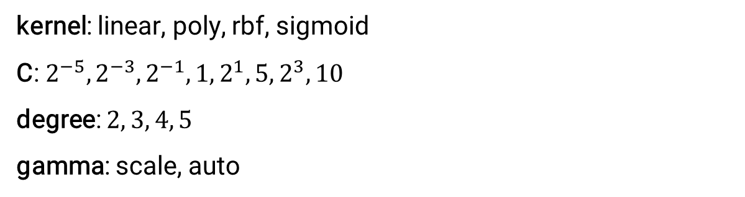
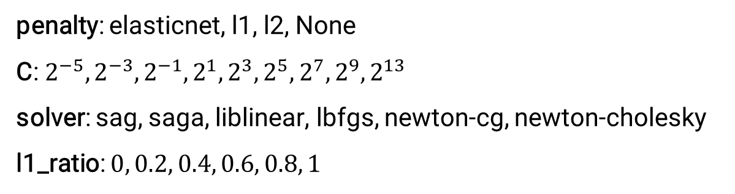
HPO Experiment
Experiment
Experiment Design
penalty: elasticnet, l1, l2, None
C: $2^{−5}, 2^{−3},2^{−1},2^{1},2^{3},2^{5},2^{7},2^{9},2^{13}$
solver: sag, saga, liblinear, lbfgs, newton-cg, newton-cholesky
l1_ratio: $0, 0.2, 0.4, 0.6, 0.8, 1$
Logistic Regression
1
Total Combinations: 171
kernel: linear, poly, rbf, sigmoid
C: $2^{−5},2^{−3},2^{−1}, 1, 2^{1}, 5, 2^{3}, 10$
degree: $2, 3, 4, 5$
gamma: scale, auto
Support Vector Classifier
2
Total Combinations: 112
(Guangli el al., 2011) | (Kristof and Dirk, 2008)
Notes:
And here shows the hyperparameters for logistic regression and support vector classifier.

Slide 37
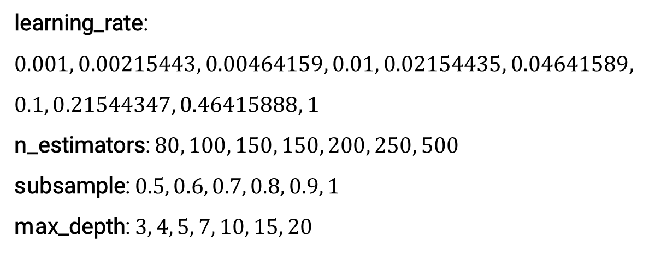
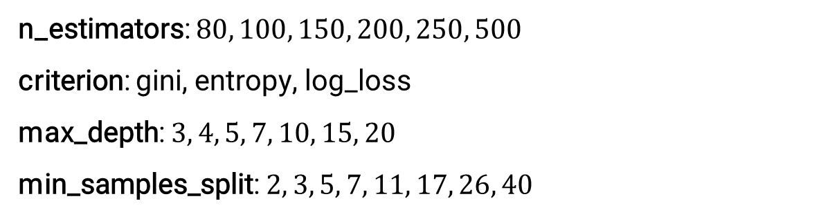
HPO Experiment
Experiment
Experiment Design
n_estimators: $80, 100, 150, 200, 250, 500$
criterion: gini, entropy, log_loss
max_depth: $3, 4, 5, 7, 10, 15, 20$
min_samples_split: $2, 3, 5, 7, 11, 17, 26, 40$
3
Random Forest Classifier
Total Combinations: 1008
learning_rate: $0.001, 0.00215443, 0.00464159, 0.01, 0.02154435, 0.04641589,$
$$0.1, 0.21544347, 0.46415888, 1$$
n_estimators: $80, 100, 150, 150, 200, 250, 500$
subsample: $0.5, 0.6, 0.7, 0.8, 0.9, 1$
max_depth: $3, 4, 5, 7, 10, 15, 20$
Gradient Boosting Classifier
4
Total Combinations: 2520
(Ibrahim el al., 2023)
Notes:
And then for Random Forest Classifier and Gradient Boosting Classifier

Slide 38
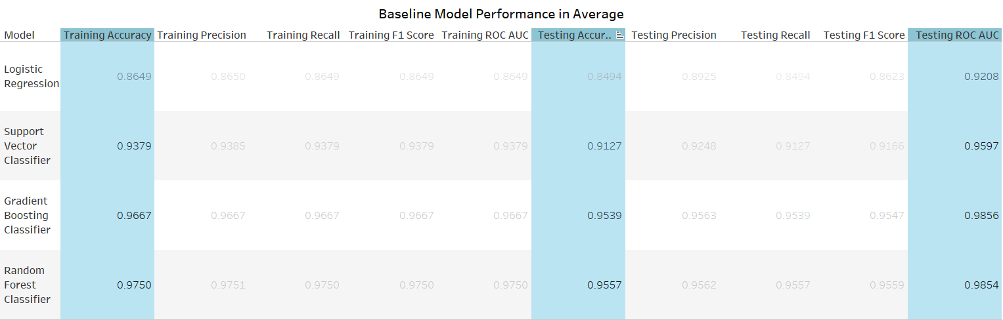
HPO Experiment
Experiment
Baseline Model
Random Forest Classifier (lead slightly) and Gradient Boosting Classifier shows similar performance, whereas Logistic Regression has the poorest score across all metrics
Notes:
For the baseline model performance, random forest classifier and gradient boosting classifier shows similar performance for testing accuracy and roc auc. Logistic regression meanwhile shows the poorest score across all metrics.

Slide 39
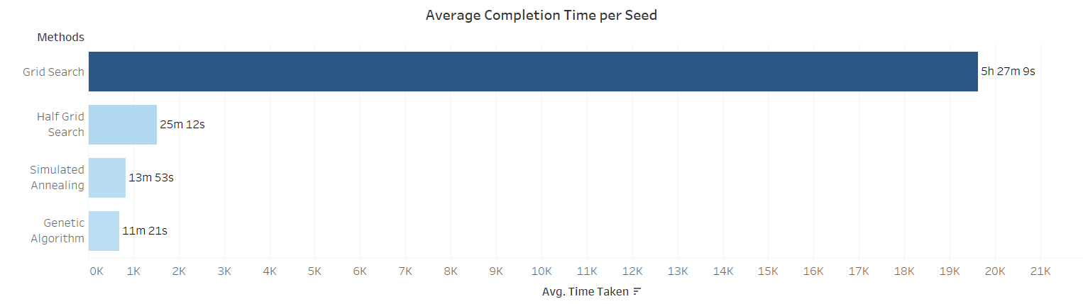
HPO Experiment
Experiment
Results and Findings
1
To measure and compare average computation
Grid Search took the longest time to complete, while Genetic Algorithm used the least amount of time
Notes:
Moving on to the results. This bar graph shows that grid search took the longest time to complete, while genetic algorithm used the least amount of time.

Slide 40
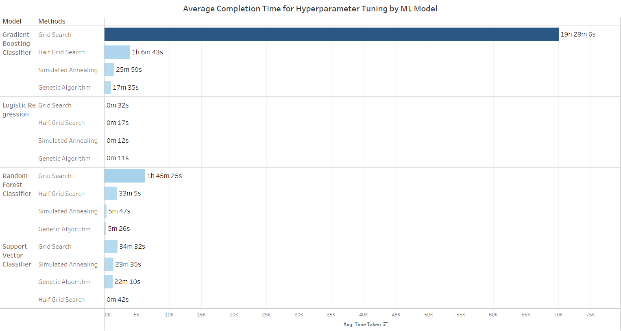
HPO Experiment
Experiment
Results and Findings
1
To measure and compare average computation
Completion Time Rank
Genetic Algorithm
Simulated Annealing
Half Grid Search
Grid Search
Notes:
When we break down by ML model, we can see that Grid Search notably takes to longest time to finish. The overall completion time is started with Genetic Algorithm that used the shortest time, followed by Simulated Annealing, Half Grid Search and Grid Search.
Support Vector Classifier – Half Grid Search notably use least amount of time due to the performance of simpler model (using linear kernel) is picked up at the earliest iteration. This results in more solutions with linear kernel are picked up and then continue evaluated until the end of iterations, which use less time to finish it.

Slide 41
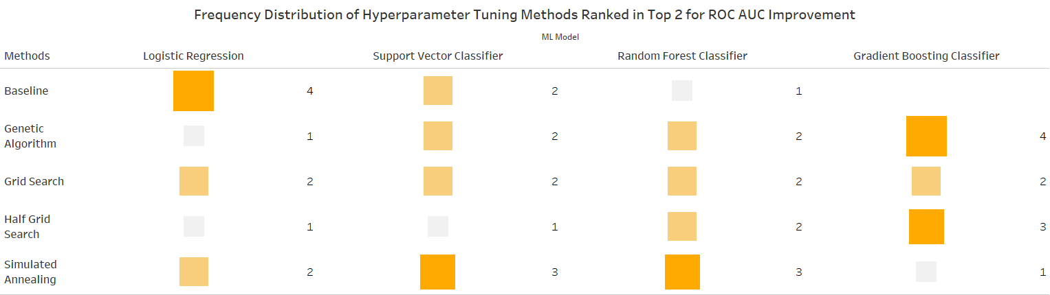
HPO Experiment
Experiment
Results and Findings
2
To assess quality of hyperparameter found
Baseline: Effective for simple models
Genetic Algorithm: Highly effective for complex models
Grid Search: Performs averagely across all cases
Half Grid Search: Shows improved effectiveness as model complexity increases
ROC AUC score is used due to imbalanced testing set
Simulated Annealing: Well-suited for models of moderate complexity
Notes:
Next. In this part, ROC AUC score is used due to the imbalanced testing set. In total, there are 5 rounds of experiments for this objective. For each round, the 2 methods that give top 2 best for ROC AUC Improvement on Testing Set will be counted.

Slide 42
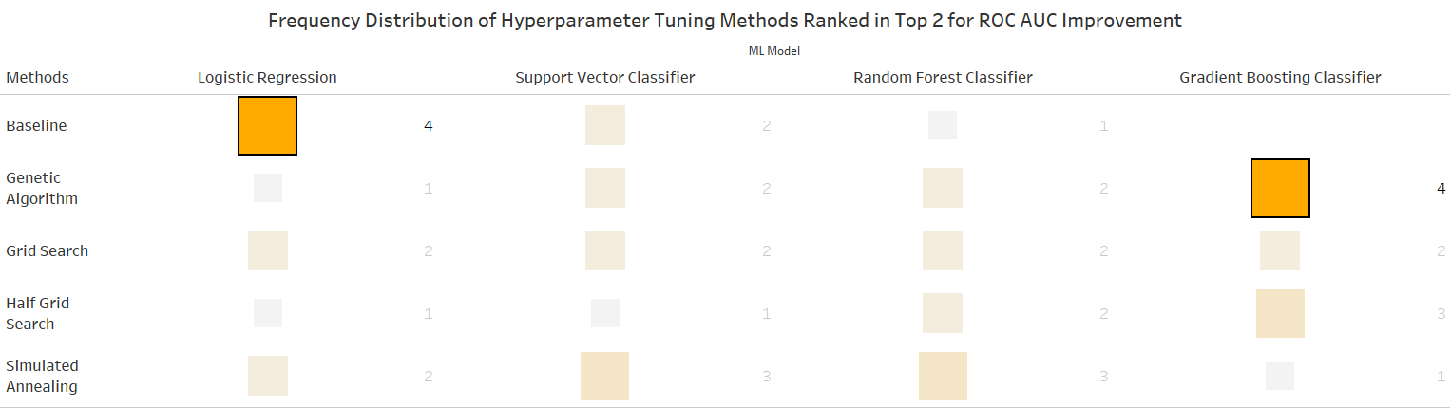
HPO Experiment
Experiment
Results and Findings
2
To assess quality of hyperparameter found
Baseline: Effective for simple models
Genetic Algorithm: Highly effective for complex models
Grid Search: Performs averagely across all cases
Half Grid Search: Shows improved effectiveness as model complexity increases
ROC AUC score is used due to imbalanced testing set
Simulated Annealing: Well-suited for models of moderate complexity
Notes:
First, baseline is effective for simple models while Genetic Algorithm is effective for complex models.

Slide 43
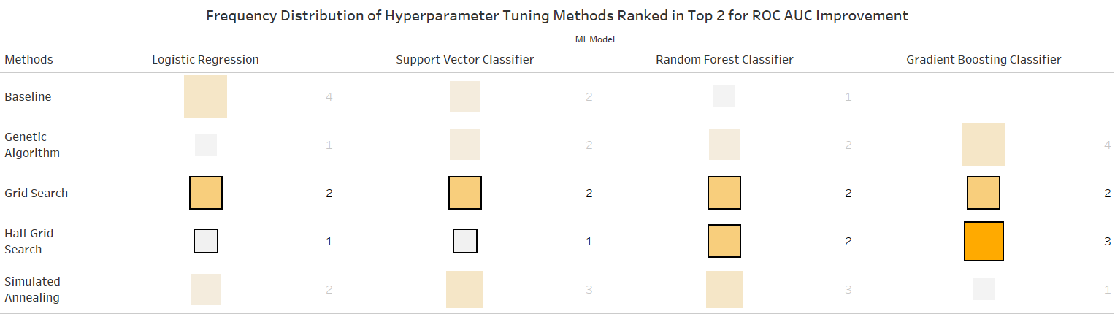
HPO Experiment
Experiment
Results and Findings
2
To assess quality of hyperparameter found
Baseline: Effective for simple models
Genetic Algorithm: Highly effective for complex models
Grid Search: Perform averagely across all cases
Half Grid Search: Show improved quality as model complexity increases
AUC ROC score is used due to imbalanced testing set
Simulated Annealing: Well-suited for models of moderate complexity
Notes:
Grid Search performed averagely across all cases, whereas Half Grid Search shows improved quality as the model complexity increases.

Slide 44
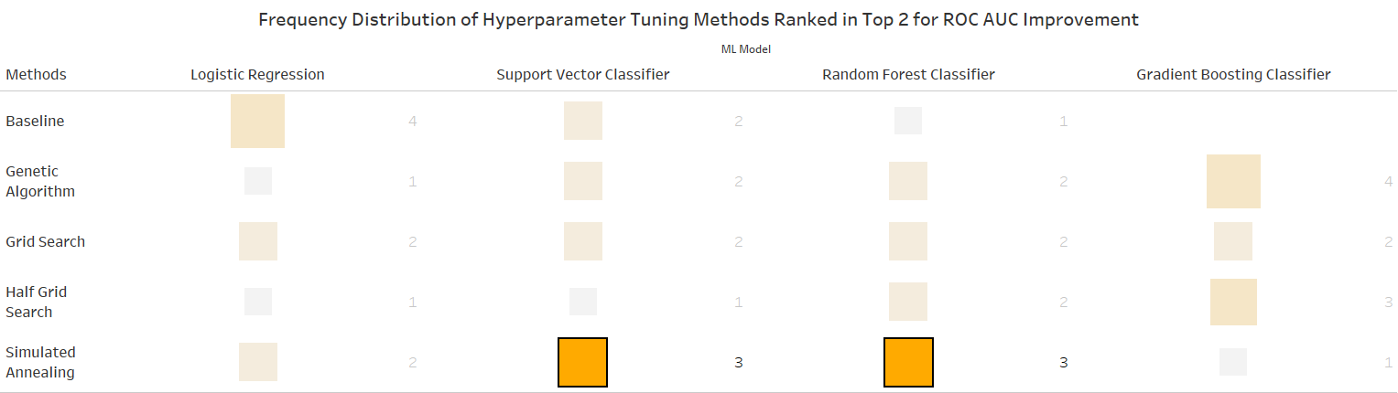
HPO Experiment
Experiment
Results and Findings
2
To assess quality of hyperparameter found
Grid Search: Performs averagely across all cases
Half Grid Search: Shows improved effectiveness as model complexity increases
Baseline: Effective for simple models
Genetic Algorithm: Highly effective for complex models
Logistic Regression has the worst performance whereas
Gradient Boosting Classifier has outperformed Random Forest Classifier after optimization
AUC ROC score is used due to imbalanced testing set
Simulated Annealing: Well-suited for models of moderate complexity
Notes:
And lastly simulated annealing is suitable for models of moderate complexity.

Slide 45
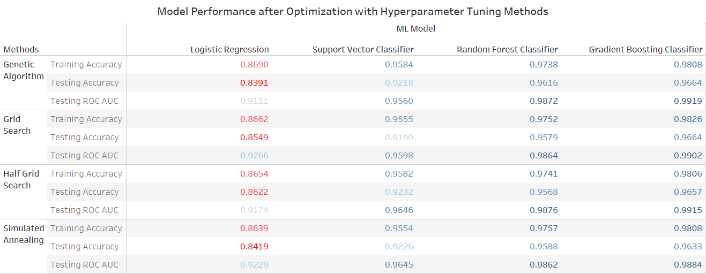
HPO Experiment
Experiment
Results and Findings
2
To assess quality of hyperparameter found
Grid Search: Performs averagely across all cases
Half Grid Search: Shows improved effectiveness as model complexity increases
Baseline: Effective for simple models
Genetic Algorithm: Highly effective for complex models
Logistic Regression has the worst performance whereas
Gradient Boosting Classifier has outperformed Random Forest Classifier after optimization
Simulated Annealing: Well-suited for models of moderate complexity
AUC ROC score is used due to imbalanced testing set
Notes:
This graph shows the actual performance metric score. We can see that logistic regression has the worst performance whereas Gradient Boosting Classifier has outperformed Random Forest Classifier after optimization.

Slide 46
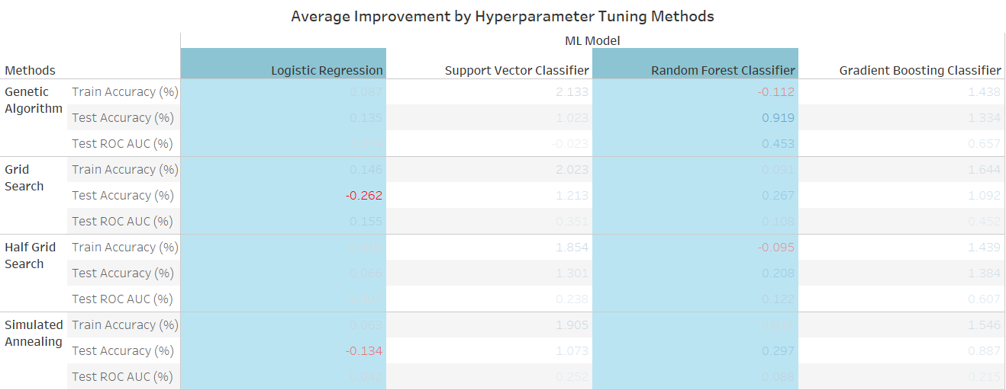
HPO Experiment
Experiment
Results and Findings
2
To assess quality of hyperparameter found
Logistic Regression and Random Forest Classifier receive less benefit after optimization
Support Vector Classifier and Gradient Boosting Classifier receive around 1-2% of improvement after optimization
Genetic Algorithm provides the greatest improvement in AUC ROC score
Notes:
When we look at the improvement rate, this graph shows that logistic regression and random forest classifier receive less benefit after optimization.

Slide 47
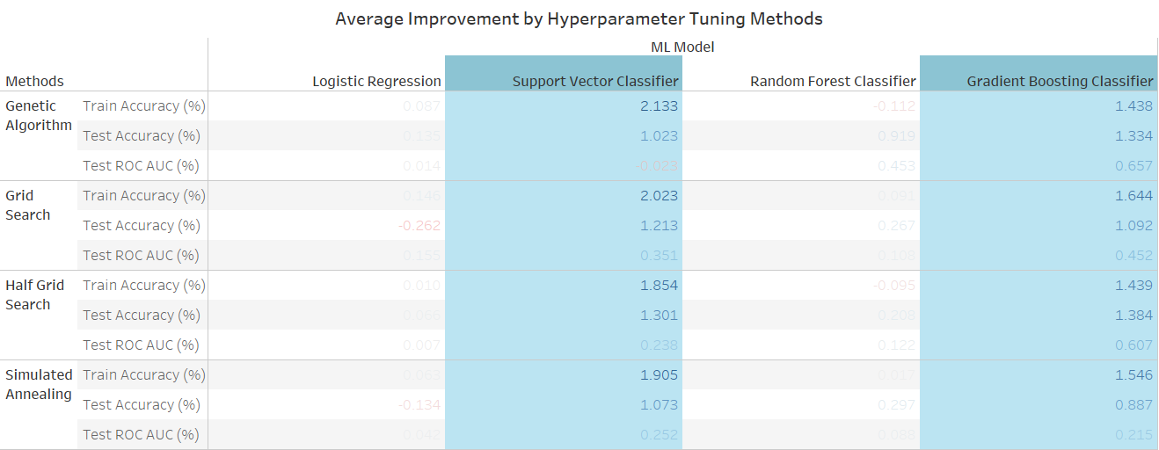
HPO Experiment
Experiment
Results and Findings
2
To assess quality of hyperparameter found
Logistic Regression and Random Forest Classifier receives less benefit after optimization
Support Vector Classifier and Gradient Boosting Classifier receive around 1-2% of improvement after optimization
Total Average Improvement Rank
Genetic Algorithm > Grid Search > Half Grid Search > Simulated Annealing
Notes:
Whereas support vector classifier and gradient boosting classifier receive around 1-2% improvement after optimization

Slide 48
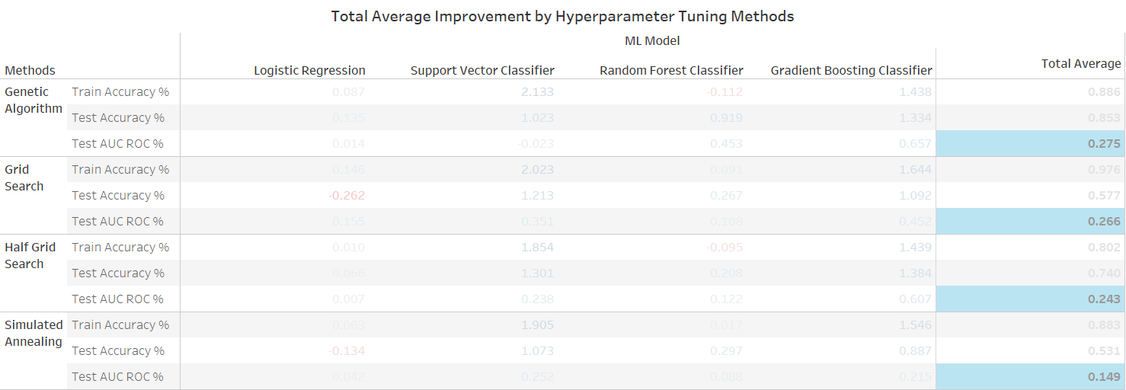
HPO Experiment
Experiment
Results and Findings
2
To assess quality of hyperparameter found
Logistic Regression and Random Forest Classifier receives less benefit after optimization
Total Average Improvement Rank
Genetic Algorithm > Grid Search > Half Grid Search > Simulated Annealing
Support Vector Classifier and Gradient Boosting Classifier receives around 1-2% of improvement after optimization
Notes:
Overall, genetic algorithm gave the highest improvement, followed by Grid Search, Half Grid Search and Simulated Annealing

Slide 49
HPO Experiment
Experiment
Results and Findings
3
To quantify exploratory capability of each method
Represent hyperparameter solutions in higher dimensions
Numerical Parameter
Categorical Parameter
Calculate Distance
Perform min-max normalization
Perform one-hot encoding
Find difference with Manhattan distance and calculate total average
(Jeroen and Joaquin, 2021)
Notes:
The last finding is related to third objective. For this, the hyperparameter solutions have to be represented in higher dimensions. And the diagram here show the process.
(Optional)
For this objective, it calculates the difference between hyperparameter points using Manhattan distance. It will find the total pairwise distance for all points and then calculate its average.
(Optional)
Manhattan distance is used in paper published by Jeroen and Joaquin in 2021. They used Manhattan distance to measure the similarity of two configurations for every hyperparameter. Manhattan distance is more encouraged compared to other distance metric like Euclidean distance because it is less sensitive to outliers and it actually measure path that parallel to the axes for each parameter, which represent a more realistic path when measuring the distance.

Slide 50
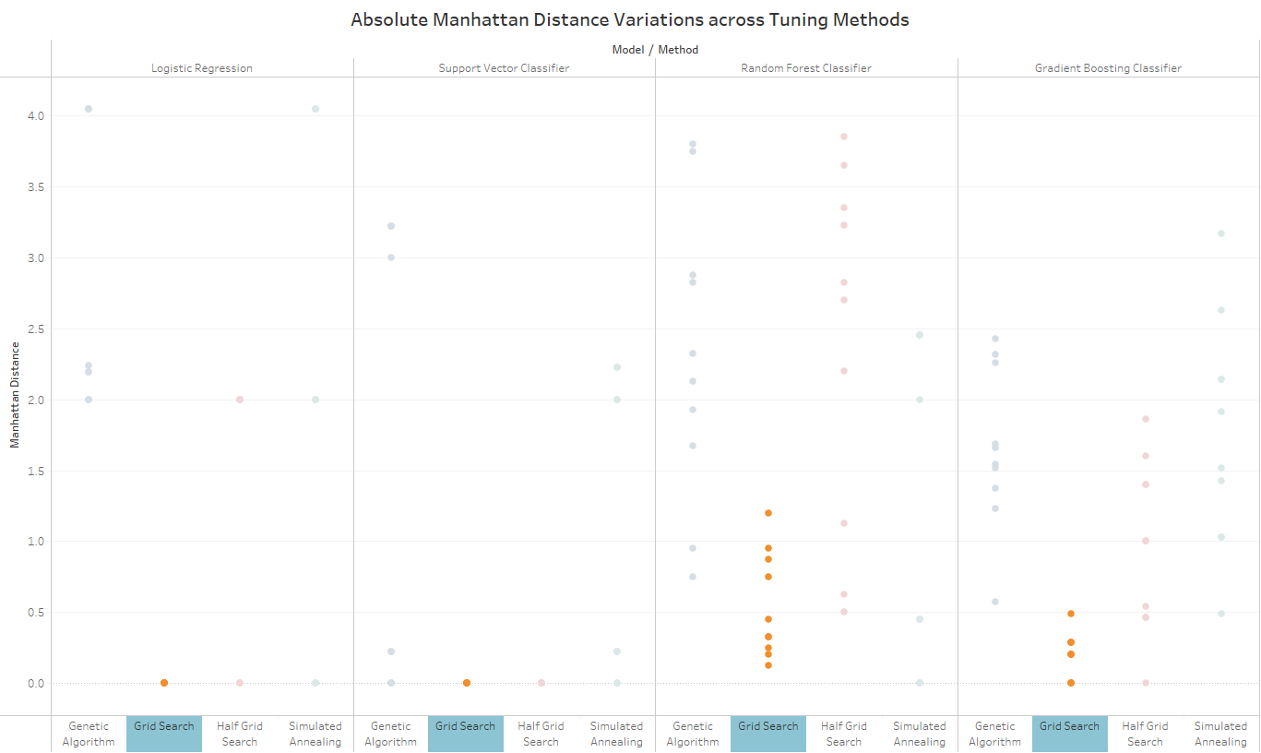
HPO Experiment
Experiment
Results and Findings
3
To quantify exploratory capability of each method
Grid Search has an obvious smaller spread of Manhattan distance across every model
Notes:
This graph shows the points plotted with its Manhattan Distance value. If we focus on Grid Search, we can see that Grid Search has smaller spread compared to others in every model.

Slide 51
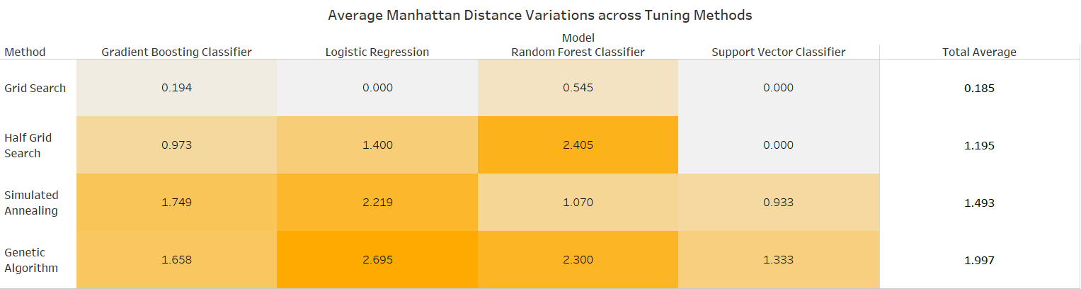
HPO Experiment
Experiment
Results and Findings
3
To quantify exploratory capability of each method
Higher average distance variation -> Have more different sets of solutions
Have more different sets of solutions -> Greater exploratory capability
Total Average Manhattan Distance Variations Rank
Genetic Algorithm > Simulated Annealing > Half Grid Search > Grid Search
Notes:
This graph shows the average of Manhattan distance variation. A higher average distance variation means that that method has produced more sets of solutions, which corresponding to its greater exploratory capability when searching the solution.

Slide 52
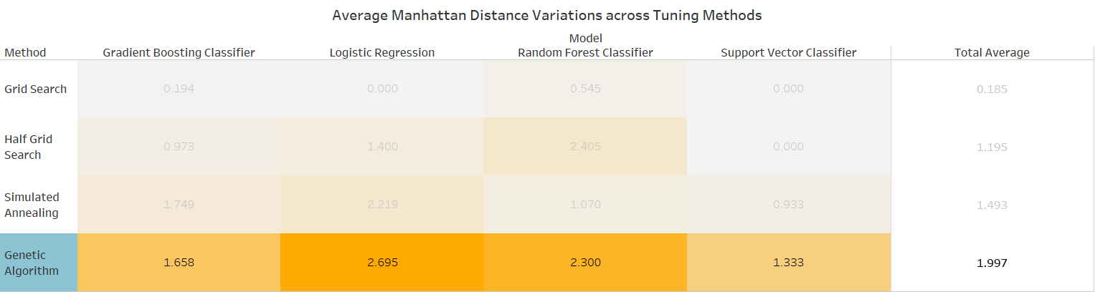
HPO Experiment
Experiment
Results and Findings
3
To quantify exploratory capability of each method
Higher average distance -> Greater exploratory capability
Greater exploratory capability -> Find more different sets of hyperparameters
Total Average Manhattan Distance Variations Rank
Genetic Algorithm > Simulated Annealing > Half Grid Search > Grid Search
Notes:
When we sum up these average, it shows that genetic algorithm has the highest exploratory capability, followed by Simulated Annealing, Half Grid Search and lastly Grid Search.

Slide 53
HPO Experiment
DEMONSTRATION
Notes:
Next, let’s move on to Demonstration

Slide 54




HPO Experiment
Demonstration
Streamlit Demonstration
Notes:
Here are the screenshots from demo just now.

Slide 55




HPO Experiment
Demonstration
Streamlit Demonstration

Slide 56
HPO Experiment
Conclusion and Future Works
4 different machine learning models have been built to assess their prediction capabilities in credit card churn analysis, with Support Vector Classifier and Gradient Boosting Classifier showed obvious improvements after optimization.
1
2
Completion Time: Genetic Algorithm < Simulated Annealing < Half Grid Search < Grid Search
Solution Quality: Genetic Algorithm > Grid Search > Half Grid Search > Simulated Annealing
Exploratory Capability: Genetic Algorithm > Simulated Annealing > Half Grid Search > Grid Search
Further researches need to be conducted on other types of problems (regression) and focused on more machine learning models and deep neural networks.
3
Notes:
In conclusion, HPO experiment has successfully built 4 machine learning model to access their prediction capabilities in credit card churning. Notably, Support Vector Classifier and Gradient Boosting Classifier showed obvious improvement after optimization. Also, the experiment managed to assess 4 hyperparameter tuning methods from 3 different aspects, which are completion time, solution quality and exploratory capability. However, since this study is limited to churn prediction, further researches need to be conducted on other types of problems like regression and should focus on more ML models and deep neural networks.

Slide 57
Thank You
Notes:
That’s all for my data science project. Thanks for listening.

